Slide 1
Content Delivery System
Presented By:-
Aman Gupta(IWM2017006)
Shubham(IWM2017004)

Slide 2
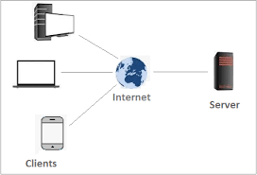
Client-Server Model
We used a client-server model for our application . In this model computers such as servers provide the network services to the other computers such as clients to perform user based tasks.

Slide 3
Client Server Protocol
We used TCP/IP protocol suite to communicate with servers. TCP is a connection-oriented protocol, which means a connection is established and maintained until the application programs at each end have finished exchanging messages. It determines how to break application data into packets that networks can deliver, sends packets to and accepts packets from the network layer, manages flow control and handles retransmission of dropped or garbled packets as well as acknowledgement of all packets that arrive.

Slide 4
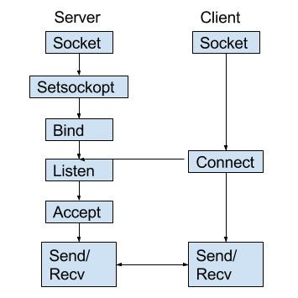
Socket Programing
We used Socket programming in python to implement client-server model , Socket programming is a way of connecting two nodes on a network to communicate with each other. One socket(node) listens on a particular port at an IP, while another socket reaches out to the other to form a connection. Server forms the listener socket while the client reaches out to the server.

Slide 5
Hardware
They can compromise on a single processor, 8GB RAM but have t
Space :- Initially we have taken 1TB Space.(Note : According to size of client -server model you increase or decrease it).
Ram:-At least 256 MB of RAM. The amount of RAM needed depends on the number of concurrent client connections.(Note : According to size of client -server model you increase or decrease it).
Display monitor, Keyboard, Mouse as required.
Webcam or any camera device to connect to monitor.
Microphone and speaker for audio streaming.
Any computer that is to be connected to a network, needs to have a network interface card (NIC).Most modern computers have these devices built into the motherboard, but in some computers you have to add an extra expansion card.
Network Cable :- To connect together different devices to make up a network, you need cables..
Hub :- A hub is a device that connects a number of computers together to make a LAN.

Slide 6
Software
Python:- You need Python 3.7.x or above.
Module :- Pyaudio, Wave, Socket, Thread, cv2.
Operating System
Linux , Windows , Mac.
Protocol
IPV4 :- At the Network layer we used IPV4 protocol.pv4 (Internet Protocol version 4) Internet address is 32 bit integers. The IP stands for Internet Protocol.
TCP :- At Transport Layer we used TCP (Transmission Control Protocol) .
ARP (Address Resolution Protocol):- Functions performed at this level include encapsulation of IP datagrams into the frames transmitted by the network and mapping of IP addresses to the physical addresses used by the network (provided by ARP protocol).
Network
LAN(Local Area Network) : IN LAN we used Ethernet.

Slide 7
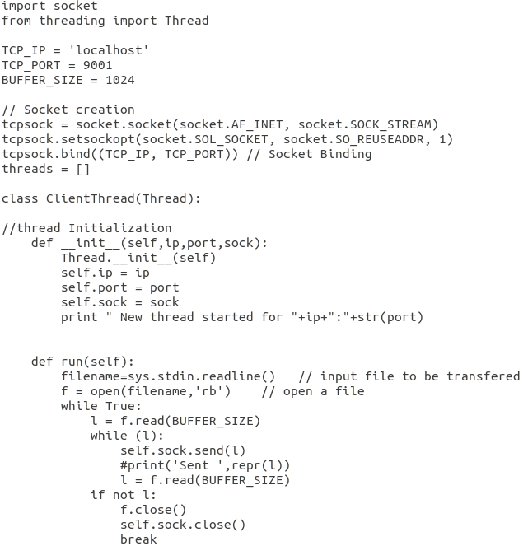
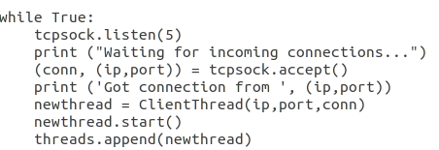
File Transfer
Algorithm to send a file(Audio,Video,text) from a local server to a local client. We used multithreading to let the server interact with multiple client.
Server

Slide 8
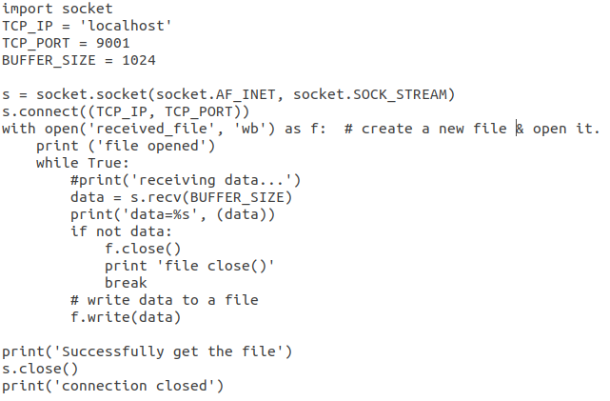
Client

Slide 9
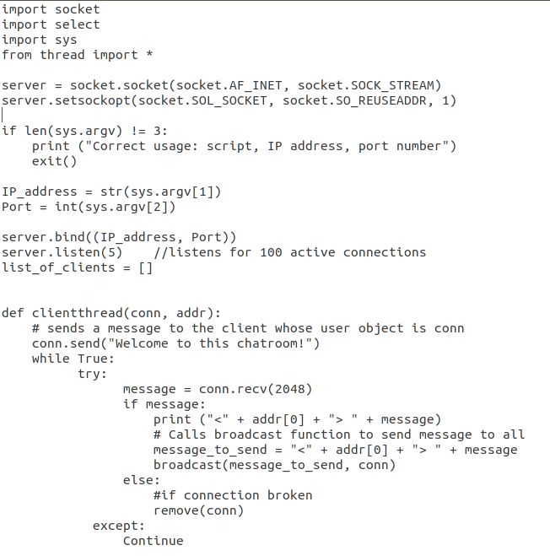
Chat
Algorithm to set up Chat Room server and allow multiple clients to connect to it using a client-side script.
Server

Slide 10
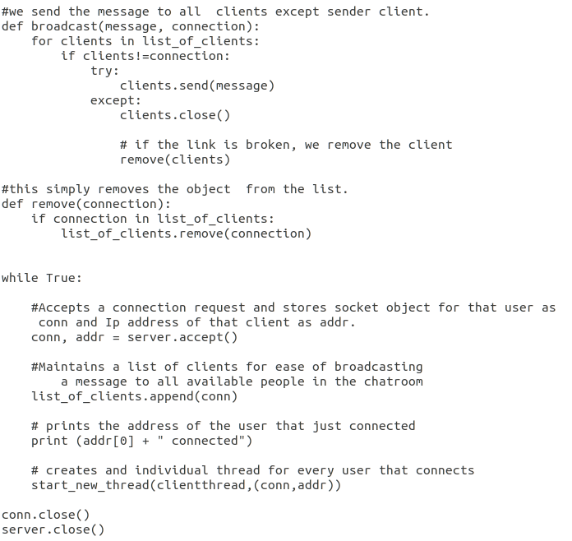

Slide 11
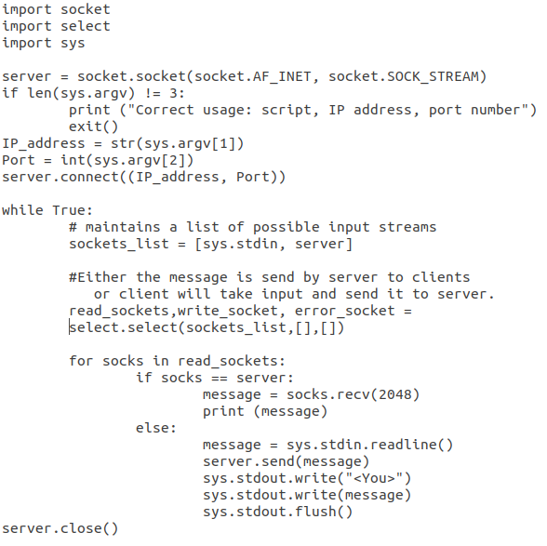
SERVER

Slide 12
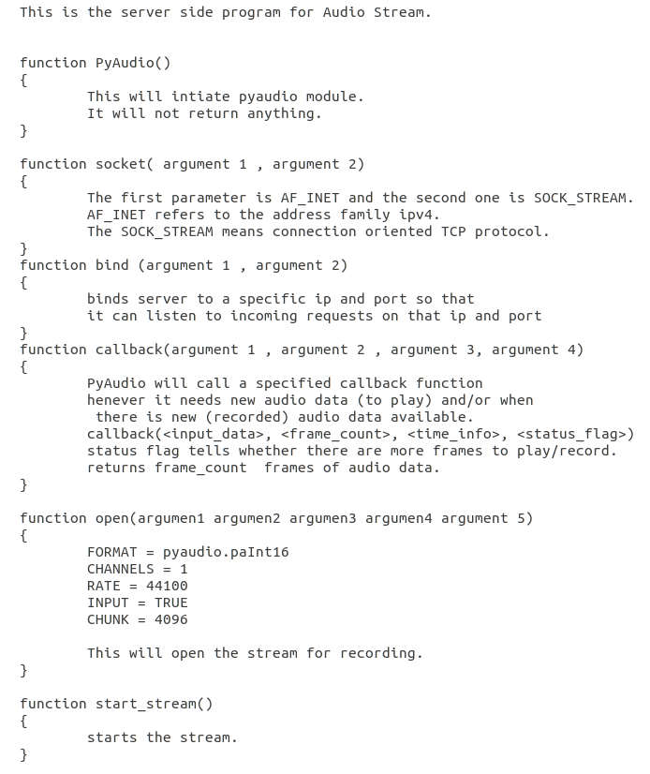
AUDIO STREAM
Below algorithm shows how the audio streaming happens using the client server model.
SERVER

Slide 13
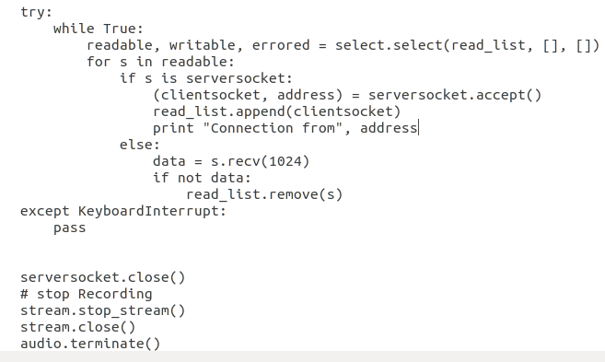

Slide 14
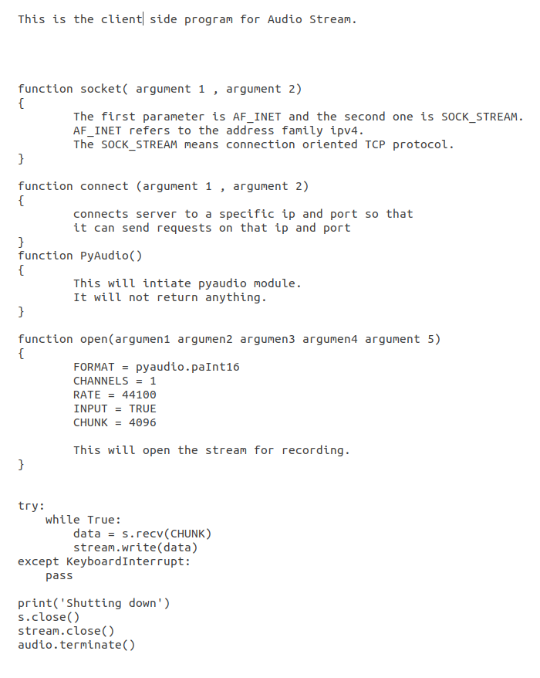
CLIENT

Slide 15
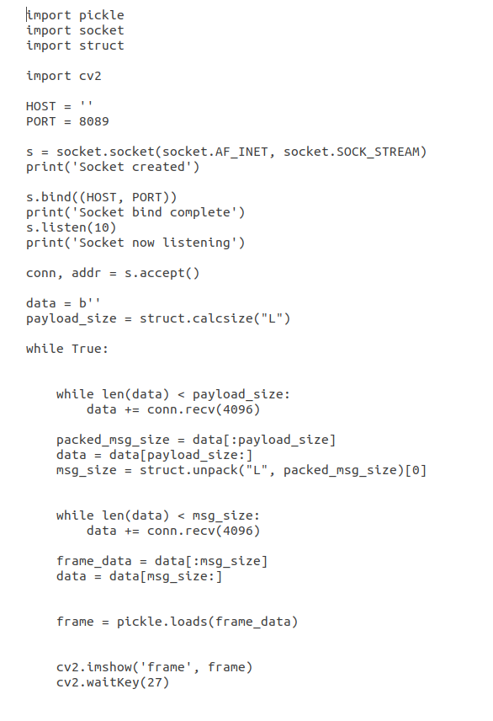
VIDEO STREAM
Algorithm to shows how the video streaming happens using the client server model.
SERVER

Slide 16
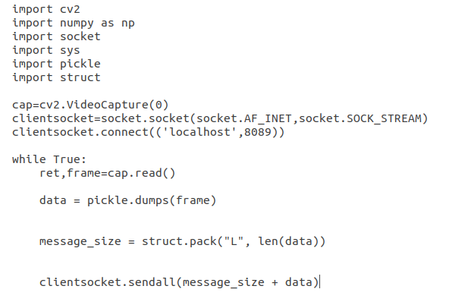
CLIENT

